Slide 1

Fuente de Soda
Antojitos
Express

Slide 2
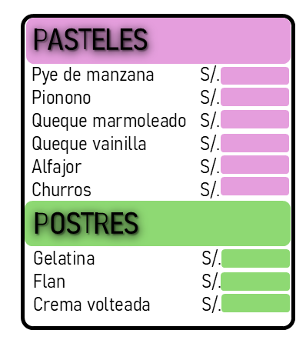
JUGOS
EMPANADAS
BEBIDAS CALIENTES
BEBIDAS FRIAS
Manzanilla S/.
Anís S/.
Té S/.
Café S/.
Café con leche S/.
Chicha morada S/.
Maracumango S/.
Limonada S/.
Coca Cola S/.
Inca Kola S/.
Agua Mineral S/.
Surtidos S/.
Fresa S/.
Papaya S/.
Plátano S/.
Piña S/.
Mango S/.
Naranja S/.
Fresa S/.
Especial S/.
Pollo S/.
Carne S/.
Queso S/.
SANDWICHS
Pollo S/.
Palta S/.
Queso S/.
Aceituna S/.

Slide 3
